Slide 1

8th Grade Math: Pre-Algebra
Unit 6, Lesson 5 Proportional Relationships and Similar Triangles Volume 1, pg. 261

Slide 2


Benchmark
MA.8.GR.2.4
Solve mathematical and real-world problems involving proportional relationships between similar triangles.
volume 1, pg. 261

Slide 3
Integrated Mathematical Thinking and Reasoning Standards
MA.K12.MTR.1.1 Actively participate in effortful learning both individually and collectively.
MA.K12.MTR.2.1 Demonstrate understanding by representing problems in multiple ways.
MA.K12.MTR.4.1 Engage in discussions that reflect on the mathematical thinking of self and others.
MA.K12.MTR.5.1 Use patterns and structure to help understand and connect mathematical concepts.
volume 1, pg. 261

Slide 4

Learning Target
I can solve mathematical problems using similar triangles.
volume 1, pg. 261

Slide 5

Warm-Up
volume 1, pg. 261

Slide 6
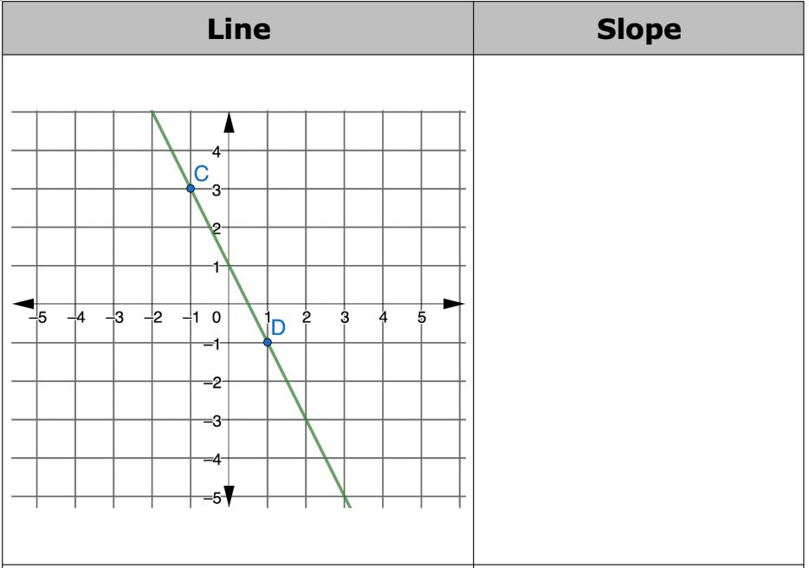
6.5.1 Warm-Up: Finding Slope
Find the slope of each line using the given information.
volume 1, pg. 261

Slide 7
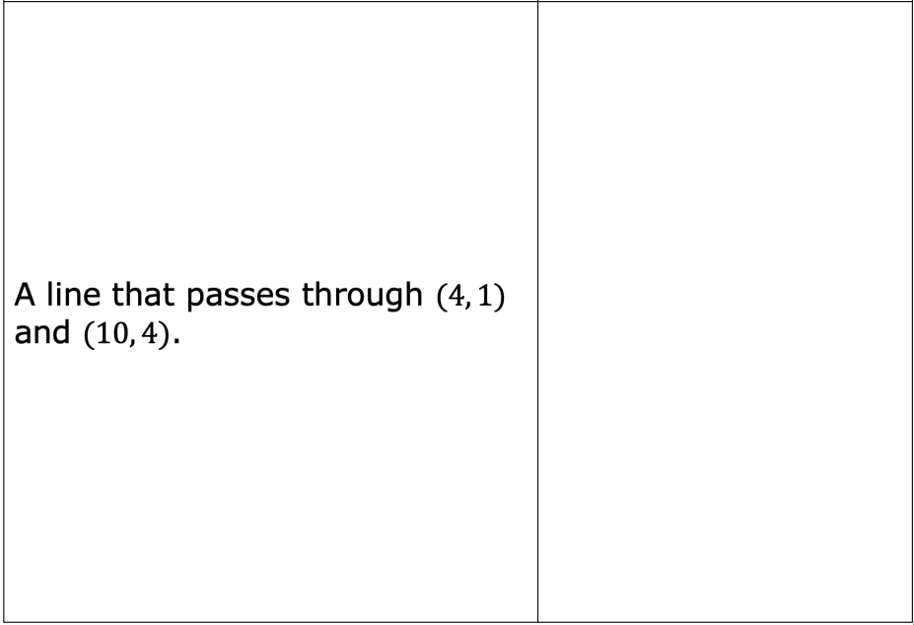
volume 1, pg. 261

Slide 8

Exploration
volume 1, pg. 262

Slide 9

6.5.2 Exploration: Ratios & Similar Triangles
Triangle 𝐴𝐵𝐶 is shown.
Lauren wants to create three new triangles that have the same shape as triangle 𝐴𝐵𝐶, but are different sizes. She multiplies each side of triangle 𝐴𝐵𝐶 by the scale factors given in the table to determine the sides of the new triangles.
volume 1, pg. 262

Slide 10
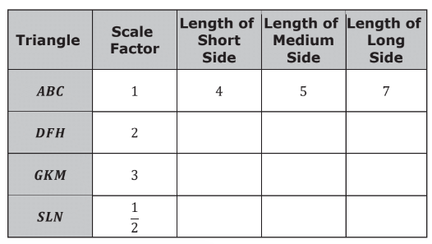
Complete the table to determine the side lengths of the three new triangles: triangle 𝐷𝐹𝐻, triangle 𝐺𝐾𝑀, and triangle 𝑆𝐿𝑁.
volume 1, pg. 262

Slide 11
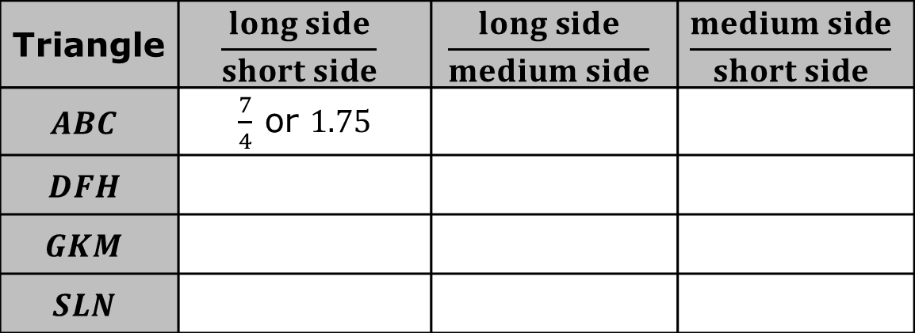
Complete the table by writing the following ratios.
Compare your answers with your partner. Then, discuss your observations of the ratios.
Triangle | $$\frac{long side}{short side}$$ | $$\frac{long side}{medium side}$$ | $$\frac{medium side}{short side}$$
$$ABC$$ | $\frac{7}{4}$ or $1.75$
$$DFH$$
$$GKM$$
$$SLN$$
volume 1, pg. 262

Slide 12

Guided Instruction
volume 1, pg. 263

Slide 13
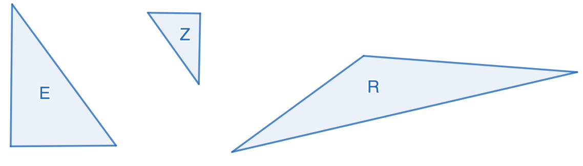
6.5.3 Guided Instruction: Similar Triangles and Proportionality
In the Exploration, the triangles created are called similar triangles. In mathematics, similar figures have the same shape, but are not necessarily the same size.
Three triangles are shown.
Discuss with your partner which two triangles appear to be similar.
volume 1, pg. 263

Slide 14
Similarity cannot be determined by appearance alone. Triangles are similar if their corresponding sides are proportional.
The Exploration used the words “long,” “medium,” and “short” to describe the sides of the triangles. Sides of similar triangles that are paired are called corresponding sides.
volume 1, pg. 263

Slide 15
Similar triangles 𝐴𝐵𝐶, 𝐷𝐹𝐻, 𝐺𝐾𝑀, and 𝑆𝐿𝑁 from the Exploration are shown.
In the Exploration, the long side of triangle 𝐴𝐵𝐶 is the side between points 𝐵 and 𝐶, called segment 𝐵𝐶.
volume 1, pg. 263

Slide 16
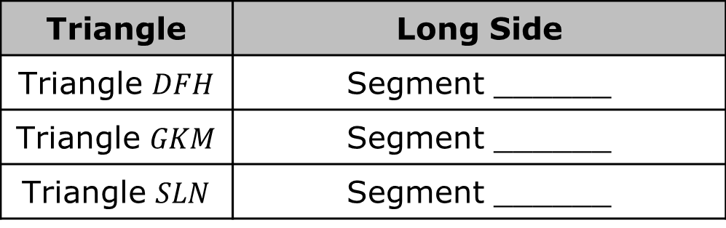
Complete the table by naming the corresponding long sides of the triangles from the Exploration.
Triangle | Long Side
Triangle $DFH$ | Segment ______
Triangle $GKM$ | Segment ______
Triangle $SLN$ | Segment ______
volume 1, pg. 263

Slide 17
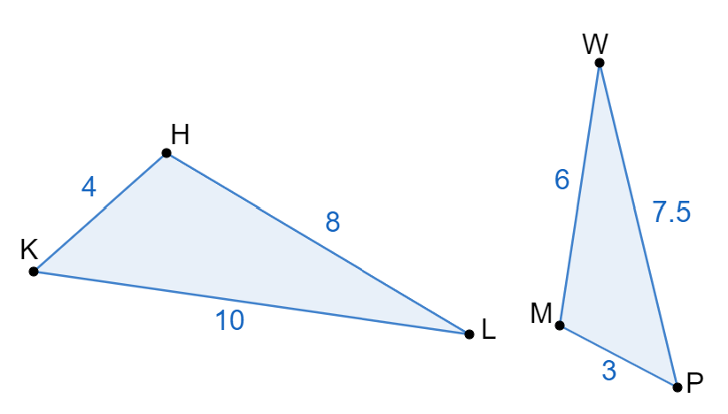
Triangle 𝐻𝐾𝐿 and triangle 𝑀𝑃𝑊 are similar.
Complete each statement to match the corresponding sides in the two similar triangles.
Segment 𝐻𝐾 corresponds with segment ______.
Segment 𝐻𝐿 corresponds with segment ______.
Segment 𝐾𝐿 corresponds with segment ______.
volume 1, pg. 264

Slide 18


The constant of proportionality between any two similar triangles is the ratio of the corresponding side lengths. For triangle 𝐻𝐾𝐿 and triangle 𝑀𝑃𝑊, the constant of proportionality is written as $\frac{corresponding side length on HKL}{corresponding side length on MPW}$.
In similar triangles, corresponding sides are proportional.
volume 1, pg. 264

Slide 19
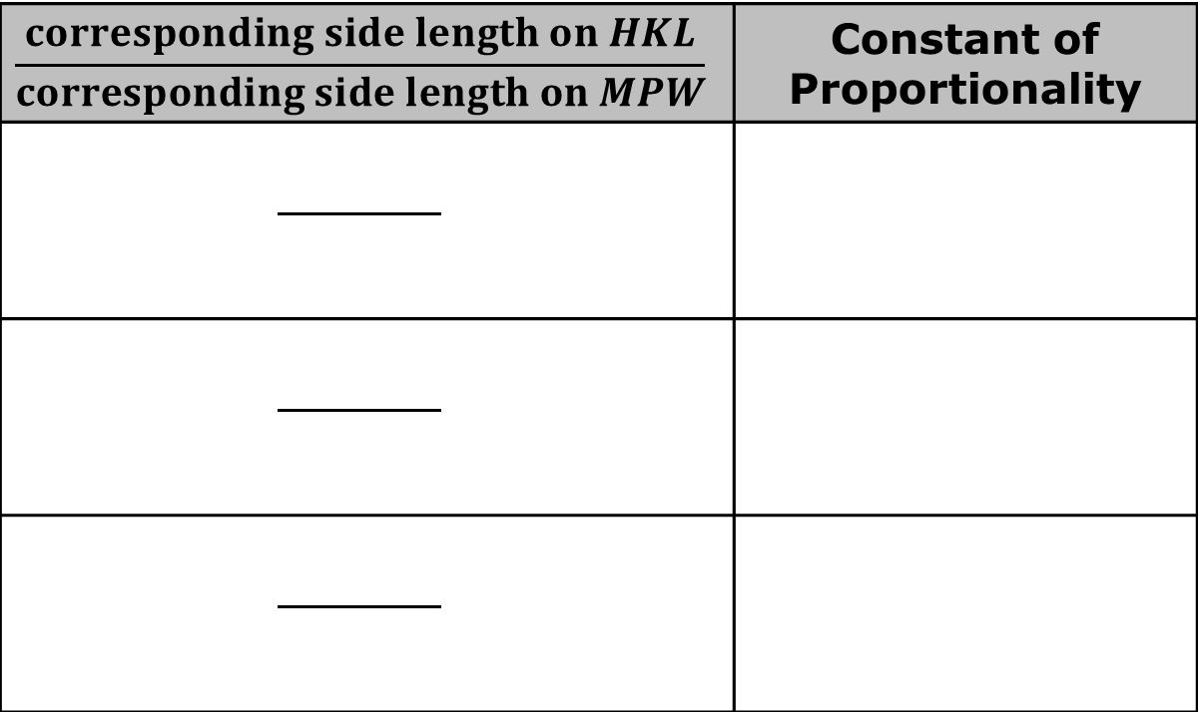
Find the constant of proportionality using each set of corresponding sides from triangle 𝐻𝐾𝐿 and triangle 𝑀𝑃𝑊.
$$\frac{corresponding side length on HKL}{corresponding side length on MPW}$$ | Constant of Proportionality
volume 1, pg. 264

Slide 20
With your partner, discuss whether it is necessary to calculate the constant of proportionality for all sets of corresponding sides, or to calculate the constant of proportionality for one set of corresponding sides.
volume 1, pg. 264

Slide 21
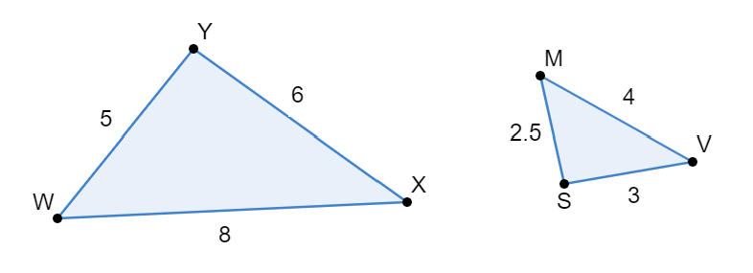
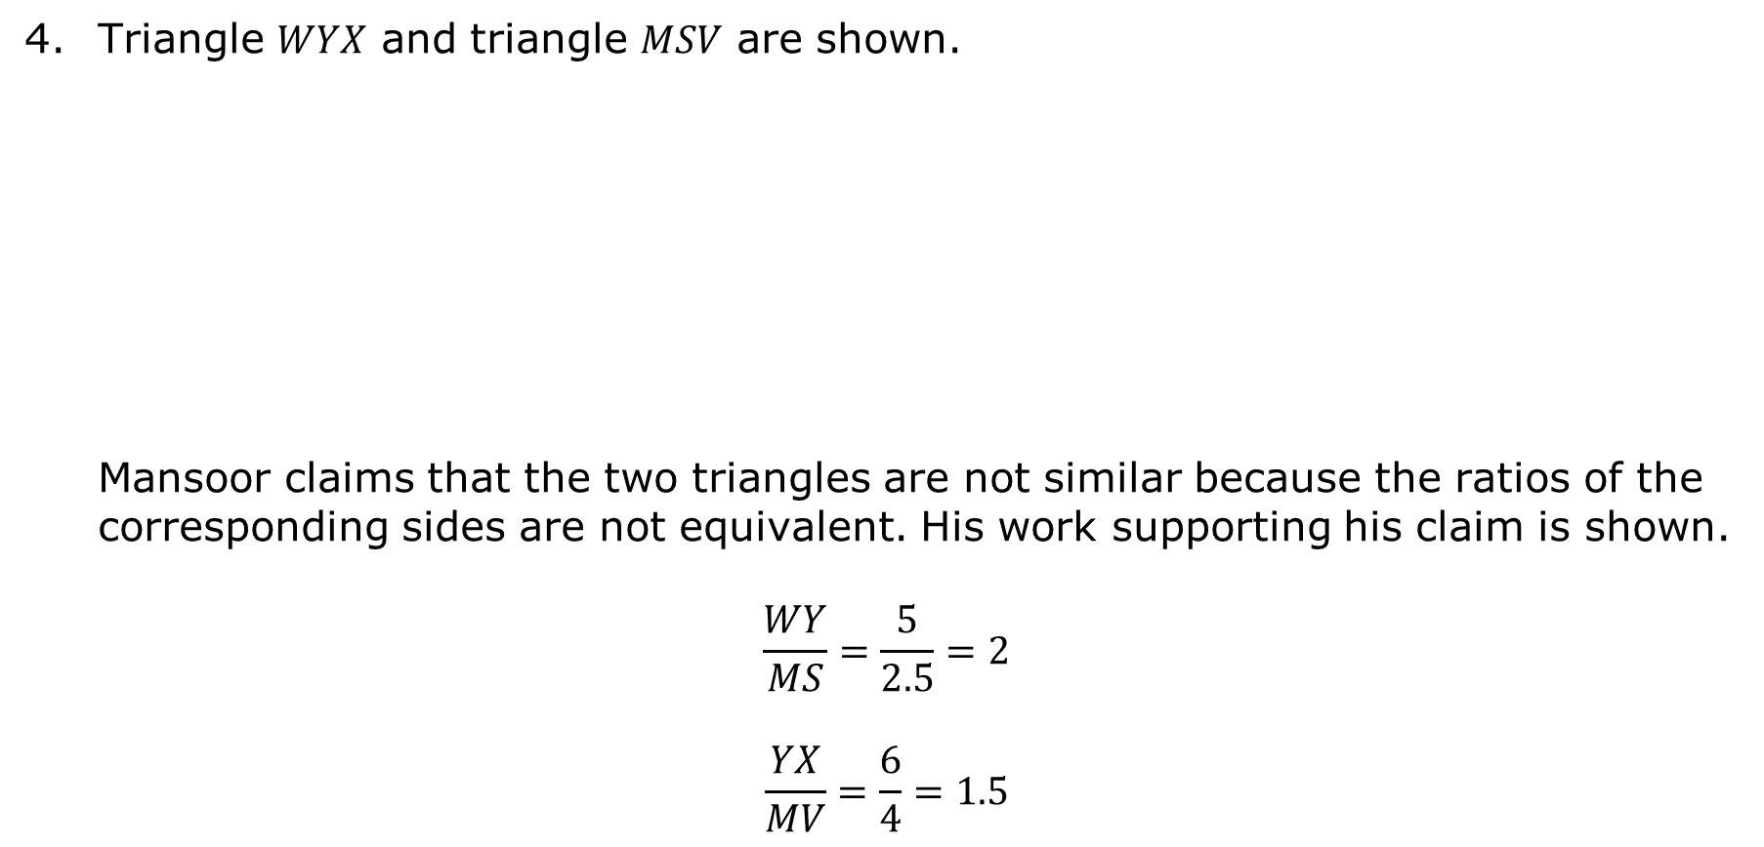
Triangle 𝑊𝑌𝑋 and triangle 𝑀𝑆𝑉 are shown.
Mansoor claims that the two triangles are not similar because the ratios of the corresponding sides are not equivalent. His work supporting his claim is shown.
$$\frac{WY}{MS}=\frac{5}{2.5}=2$$
$$\frac{YX}{MV}=\frac{6}{4}=1.5$$
volume 1, pg. 265

Slide 22
Explain whether you agree with Mansoor. Show any work that supports your answer.
Compare your work with your partner and resolve any differences, if necessary.
volume 1, pg. 265

Slide 23

Collaboration
volume 1, pg. 265

Slide 24

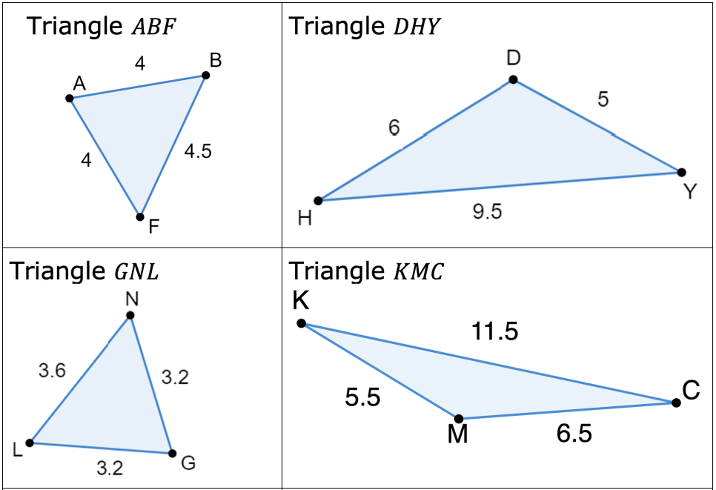
6.5.4 Collaboration: Matching Similar Triangles
Eight triangles are shown.
volume 1, pg. 265

Slide 25
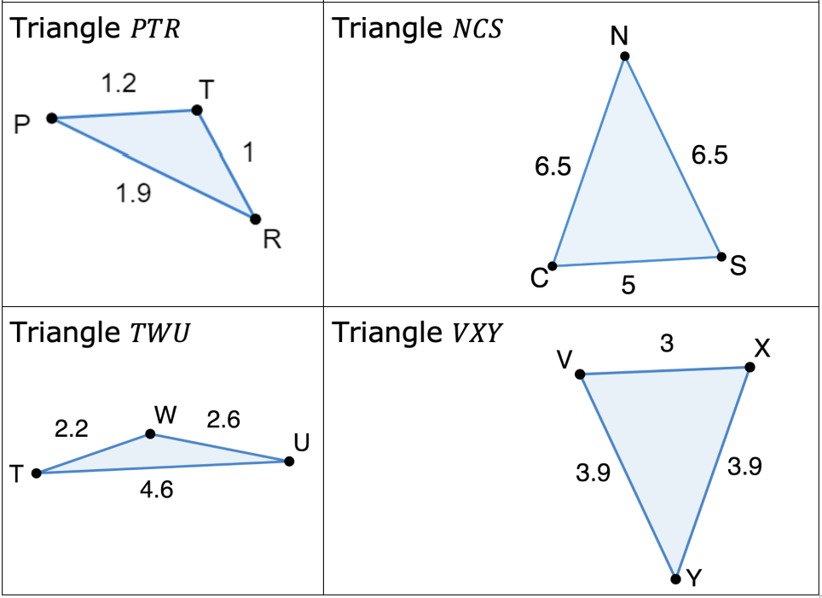
volume 1, pg. 265

Slide 26
Work with your partner to complete the table by determining each pair of similar triangles and finding the constant of proportionality for each pair.
Similar Triangles | Constant of Proportionality
Triangles _____ and _____
Triangles _____ and _____
Triangles _____ and _____
Triangles _____ and _____
volume 1, pg. 266

Slide 27

Guided Practice
volume 1, pg. 266

Slide 28

6.5.5 Guided Practice: Solving Mathematical Problems with Similar Triangles
Triangle 𝐺𝑇𝑌 is similar to triangle 𝑁𝑅𝐹.
What is the constant of proportionality between triangle 𝐺𝑇𝑌 and triangle 𝑁𝑅𝐹?
volume 1, pg. 266

Slide 29
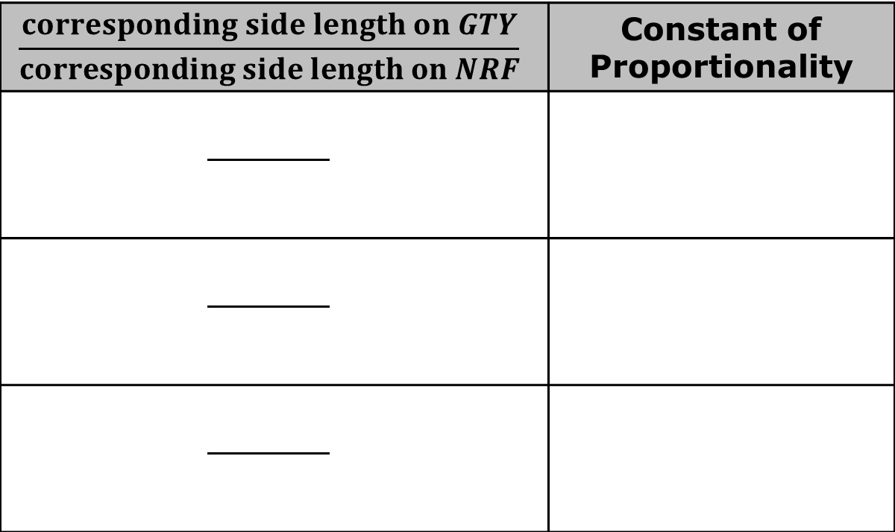
Find the lengths of the missing sides of triangle 𝑁𝑅𝐹.
Complete the table to verify your work.
$$\frac{corresponding side length on GTY}{corresponding side length on NRF}$$ | Constant of Proportionality
volume 1, pg. 266

Slide 30

Wrap-Up
volume 1, pg. 267

Slide 31

6.5.6 Wrap-Up: Reflection
For each of the statements below, circle the emoji that represents your feelings toward each statement.
I can identify the corresponding sides of similar triangles.
volume 1, pg. 267

Slide 32
I can determine whether two triangles are similar.
I can find the missing side lengths in similar triangle.
volume 1, pg. 267

